Slide 1
Q & A
if the distance of people to the camera affects the overall accuracy?

Slide 2
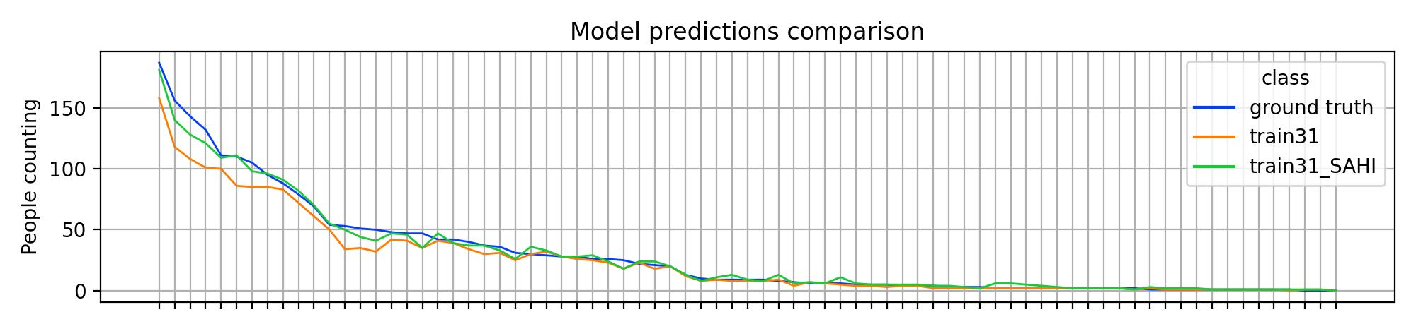

summary
The inference framework is Slicing Aided Hyper Inference and Fine-tuning for Small Object Detection
Paper: https://arxiv.org/abs/2202.06934
Framework: https://github.com/obss/sahi.git
Benchmark: https://github.com/fcakyon/small-object-detection-benchmark
Related works: https://github.com/kuanhungchen/awesome-tiny-object-detection
This framework improves the predictions on YOLOv8x and brings them closer to the actual values numerically.
This framework has been integrated with Detectron2, MMDetection, and YOLO models. It works well on our YOLOv8x.

Slide 3
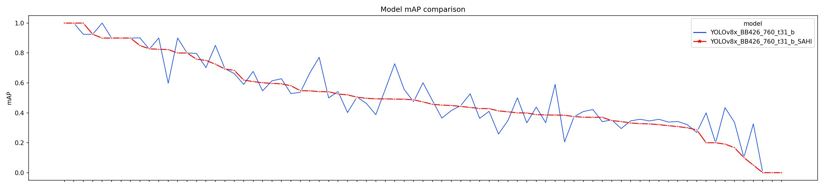
Applying SAHI on YOLOv8x increases the number of detections(compare the % columns) but not the performance(see the line plot at the bottom).
 |  | train31 |  | train31_SAHI
People in image​ | Ground truth​ | ​prediction | ​% | ​prediction | ​%
150+​ | ​171.5 | ​138.0 | ​80.5% | ​160.5 | ​93.6%
​100-150 | ​120.2 | ​96.0 | ​79.9% | ​113.4 | ​94.3%
50-100 | 69.9 | 60.0 | 85.8% | 69.7 | 99.7%
10-50 | 32.8 | 28.8 | 87.8% | 31.7 | 96.6%
0-10 | 3.45 | 3.10 | 89.9% | 4.31 | 124.9%
SAHI enable the model to detect more
objects, but also introduce more false positives.
Although the predicted number
of people increases, the accuracy is not

Slide 4
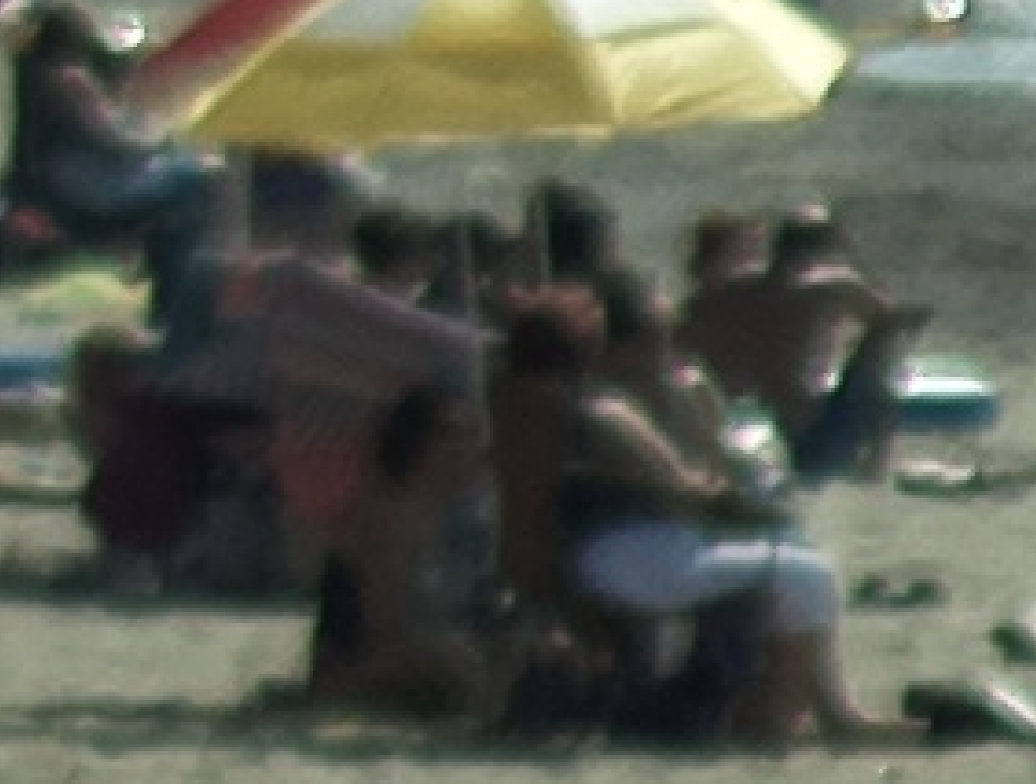
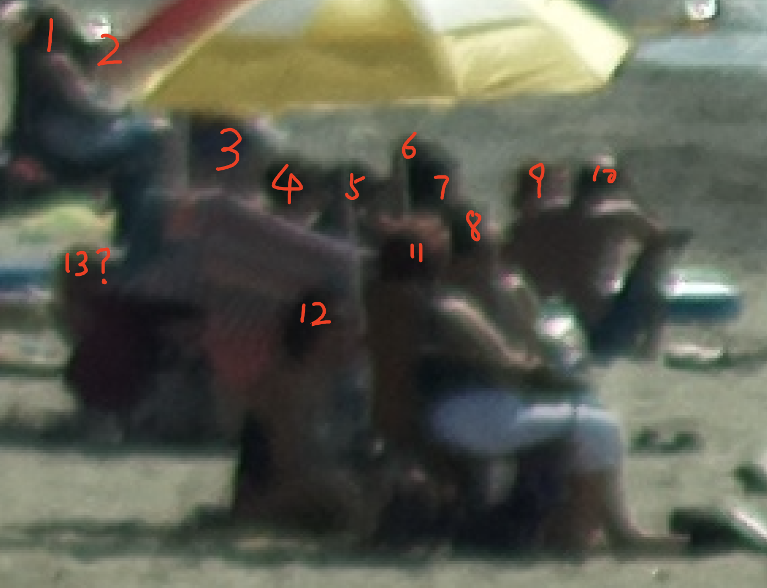
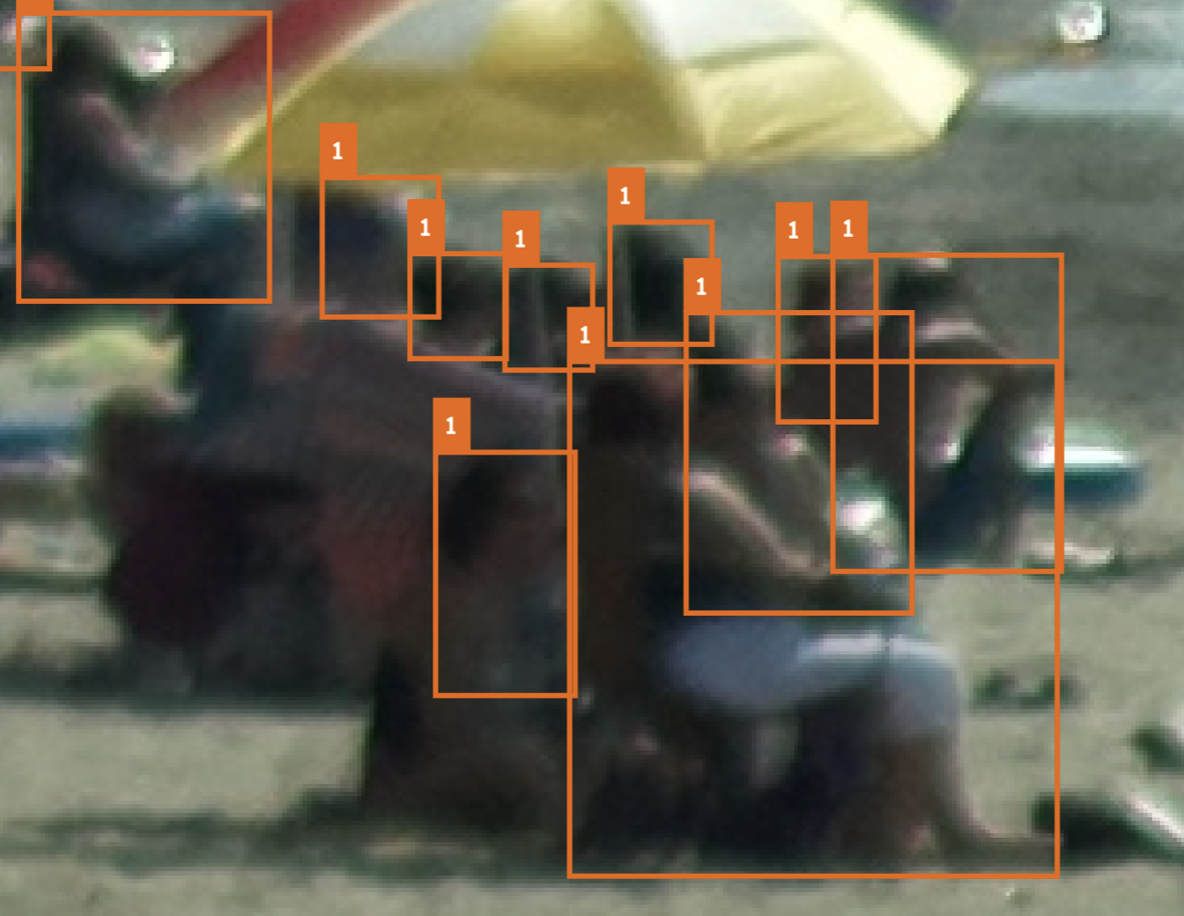
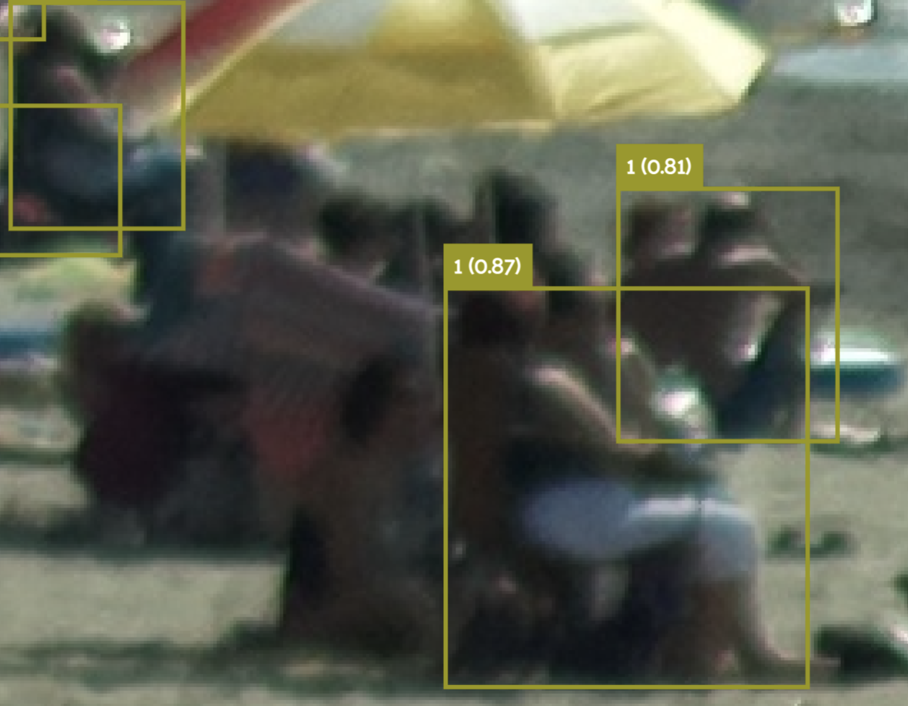
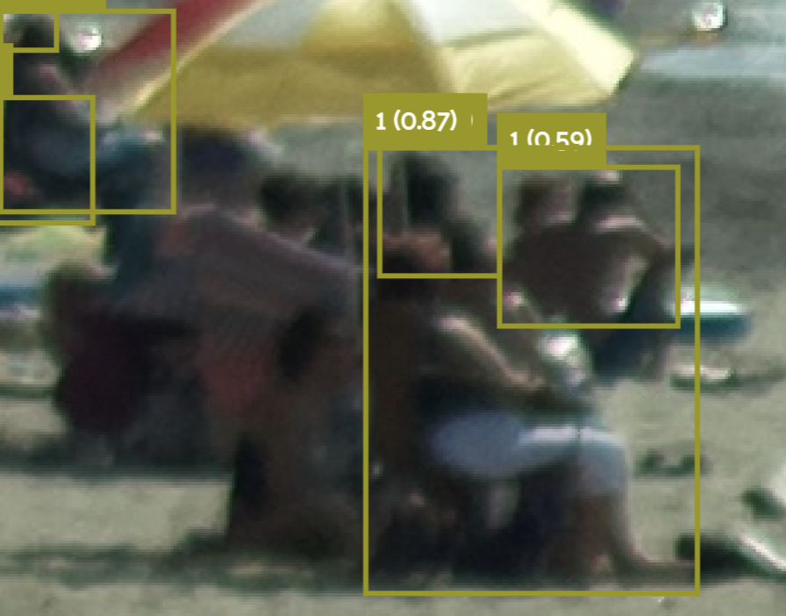
There are two main factors contributing to this phenomenon:
Aspect 1: highly-overlapped. Solution: two/multi-stage models
Aspect 2: tiny object detection. Solution: improve annotation quality
It is inherently difficult for a one-stage detector to detect highly-overlapped objects in crowded scenes because most of their detection theories are not suitable for crowded scene detection. Hong-hui Xu, etc. (March 2023). Object detection in crowded scenes via joint prediction. Defence Technology. Pages 103-115.
Aspect 1 doesn't benefit much from SAHI framework
Annotations
Predictions train31
Predictions train31_SAHI

Slide 5
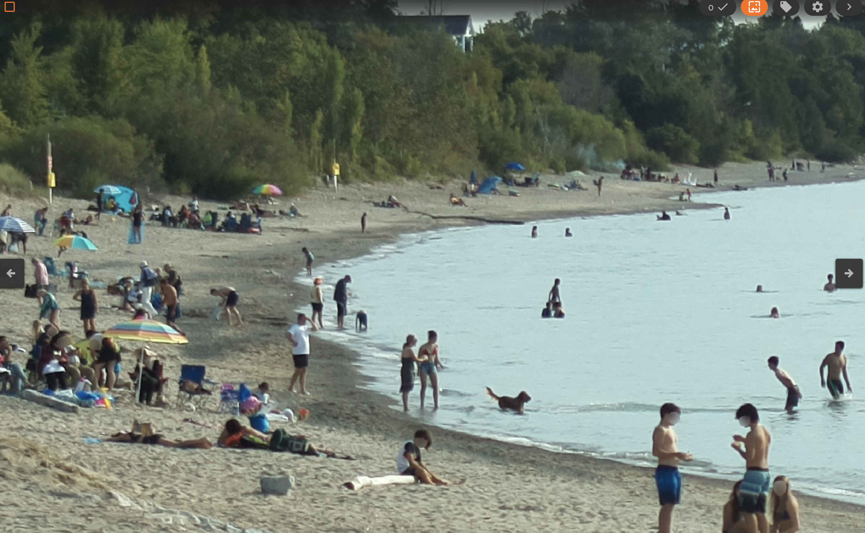
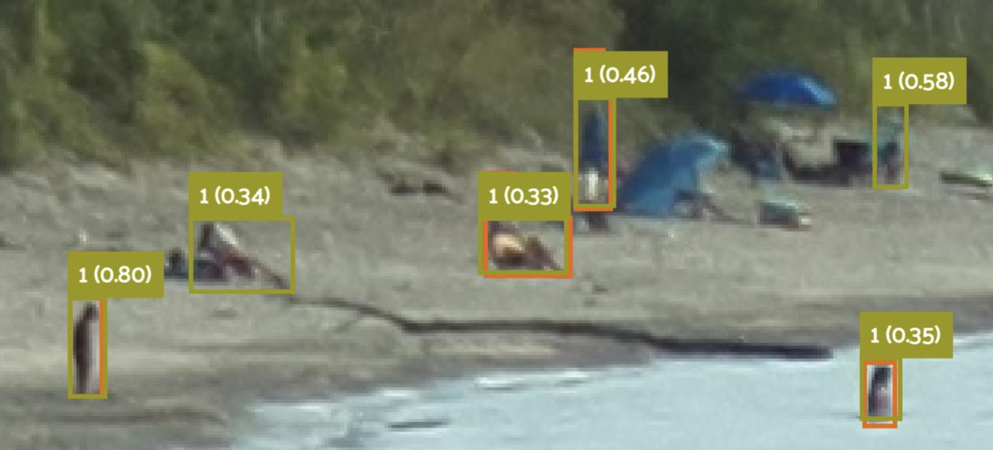
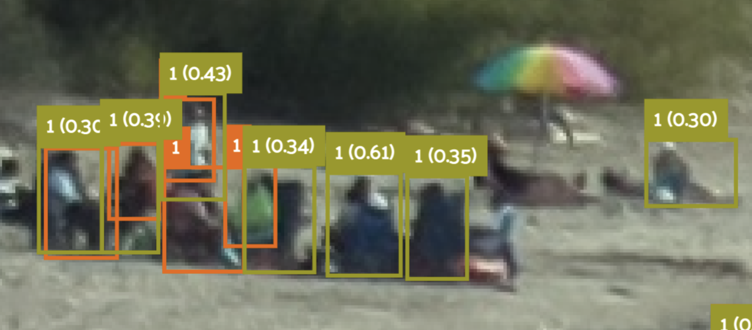
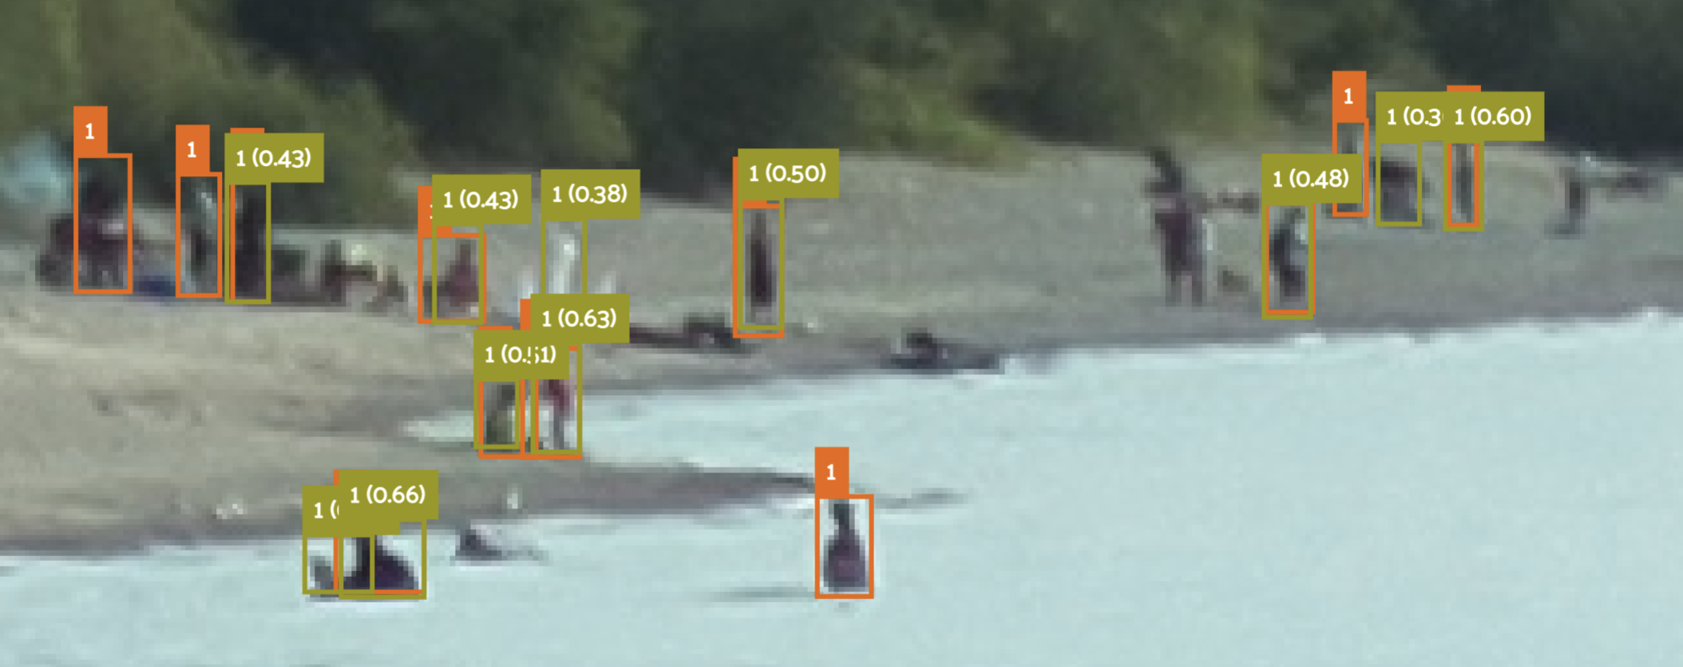
Detecting an extra person in the image could be considered a false positive and the ability to detect a potential person like this one is going to be li
Tiny object detection accuracy is limited by annotation quality: Conflict ground truth makes the model confused with whether a candidate prediction is a good prediction or a bad prediction.
Orange box with label name “1”: annotations
Yellow-green box with float confidence: predictions
White arrows: extra predictions by SAHI+YOLOv8x
Purple arrows: successfully predicted but no labels on that area. Those predictions will be considered false positives.
YOLOv8x_BB426_760_t31_b/2022-08-27_17-50-16.jpg

Slide 6
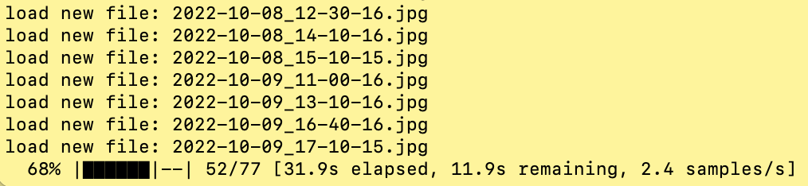
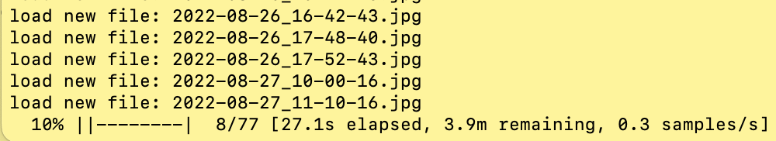
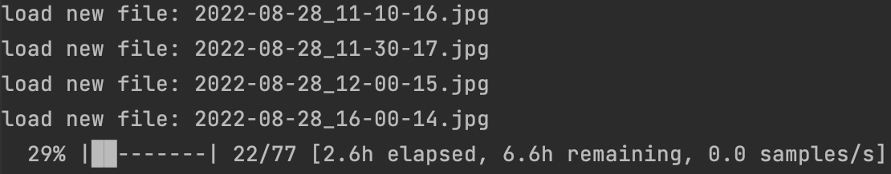
Processing speed on CPU/GPU
YOLOv8x on GPU: 2.4samples/s
SAHI_YOLOv8x on GPU: 0.3samples/s
SAHI+YOLOv8x could take several minutes per sample on a CPU-only platform

Slide 7
Slicing Aided Hyper Inference and Fine-tuning for Small Object Detection
Paper: https://arxiv.org/abs/2202.06934
Framework: https://github.com/obss/sahi.git
Benchmark: https://github.com/fcakyon/small-object-detection-benchmark
Related works: https://github.com/kuanhungchen/awesome-tiny-object-detection
Applying this Slicing Aided Hyper Inference and Fine-tuning framework to an existing model could help to improve its prediction performances.
This framework has been integrated with Detectron2, MMDetection, and YOLO models. It works well on our YOLOv8x.
跑一个 SAHI+YOLOv8 的 image 每张图片的结果：
再整理成前边 ppt 的表格，看一下 accuracy 的值提高了多少：

Slide 8
Short conclusion
Causal Analysis of Factors Affecting Accuracy
SAHI and fine-tuning
Suggestions:
Aspect 1: Better models.
Aspect 2: Needs better annotations.
Can we approximate the actual values:
With SAHI, yes
We implemented SAHI+YOLOv8x
Needs GPU to accelerate
Numerically, the prediction is closer to the actual values.
SAHI is helpful to detect small objects, but it does not contribute much to the prediction accuracy for this tested case

Slide 9
Model Prediction Comparison ground truth train31_SAHI train31
0 2022-08-28_16-20-15.jpg 187.0 181.0 158.0
1 2022-08-27_15-40-16.jpg 156.0 140.0 118.0
2 2022-08-27_15-20-15.jpg 143.0 128.0 108.0
3 2022-08-27_17-10-15.jpg 132.0 121.0 101.0
4 2022-08-27_17-50-16.jpg 111.0 109.0 100.0
5 2022-08-27_12-50-16.jpg 110.0 111.0 86.0
6 2022-08-27_17-30-16.jpg 105.0 98.0 85.0
7 2022-09-02_15-50-16.jpg 95.0 96.0 85.0
8 2022-08-28_12-00-15.jpg 88.0 91.0 83.0
9 2022-08-27_17-40-16.jpg 79.0 82.0 72.0
10 2022-08-28_11-30-17.jpg 69.0 70.0 61.0
11 2022-09-04_15-31-23.jpg 54.0 55.0 50.0
12 2022-09-10_17-57-26.jpg 53.0 50.0 34.0
13 2022-08-25_16-34-40.jpg 51.0 44.0 35.0
14 2022-09-10_18-17-26.jpg 50.0 41.0 32.0
15 2022-08-27_11-10-16.jpg 48.0 47.0 42.0
16 2022-08-29_18-03-48.jpg 47.0 46.0 41.0
17 2022-08-29_18-33-47.jpg 47.0 35.0 35.0
18 2022-08-29_13-13-48.jpg 42.0 47.0 41.0
19 2022-08-27_17-00-16.jpg 42.0 39.0 39.0
20 2022-08-28_11-10-16.jpg 40.0 37.0 34.0
21 2022-08-26_16-22-43.jpg 37.0 37.0 30.0
22 2022-08-26_16-42-43.jpg 36.0 33.0 31.0
23 2022-08-25_17-04-40.jpg 31.0 26.0 25.0
24 2022-08-28_10-40-16.jpg 30.0 36.0 30.0
25 2022-08-29_17-23-48.jpg 29.0 33.0 32.0
26 2022-08-29_17-06-47.jpg 28.0 28.0 28.0
27 2022-08-26_17-52-43.jpg 28.0 28.0 26.0
28 2022-08-26_17-48-40.jpg 26.0 29.0 25.0
29 2022-08-27_17-20-16.jpg 26.0 24.0 23.0
30 2022-08-27_10-00-16.jpg 25.0 18.0 18.0
31 2022-08-29_17-36-47.jpg 22.0 24.0 23.0
32 2022-09-11_12-40-15.jpg 21.0 24.0 18.0
33 2022-08-28_16-00-14.jpg 20.0 20.0 20.0
34 2022-08-29_15-21-08.jpg 13.0 13.0 12.0
35 2022-09-04_14-43-18.jpg 10.0 8.0 8.0
36 2022-09-10_14-41-54.jpg 9.0 11.0 9.0
37 2022-09-10_17-31-54.jpg 9.0 13.0 8.0
38 2022-09-07_17-45-59.jpg 9.0 9.0 8.0
39 2022-10-21_17-50-16.jpg 9.0 8.0 8.0
40 2022-10-24_17-30-16.jpg 8.0 13.0 9.0
41 2022-10-22_15-43-52.jpg 7.0 6.0 4.0
42 2022-09-02_15-00-16.jpg 6.0 7.0 7.0
43 2022-10-08_12-30-16.jpg 6.0 6.0 6.0
44 2022-10-09_13-10-16.jpg 6.0 11.0 5.0
45 2022-10-09_16-40-16.jpg 5.0 6.0 4.0
46 2022-10-14_16-00-16.jpg 5.0 5.0 4.0
47 2022-10-16_17-04-10.jpg 5.0 5.0 3.0
48 2022-10-18_14-10-16.jpg 4.0 5.0 4.0
49 2022-10-18_15-40-15.jpg 4.0 5.0 4.0
50 2022-09-09_08-00-16.jpg 4.0 4.0 2.0
51 2022-10-21_13-30-16.jpg 3.0 4.0 2.0
52 2022-10-08_15-10-15.jpg 3.0 3.0 2.0
53 2022-10-16_15-24-10.jpg 3.0 2.0 2.0
54 2022-09-08_10-20-16.jpg 2.0 6.0 2.0
55 2022-10-14_14-30-16.jpg 2.0 6.0 2.0
56 2022-10-27_08-50-16.jpg 2.0 5.0 2.0
57 2022-09-08_08-50-16.jpg 2.0 4.0 2.0
58 2022-10-09_17-10-15.jpg 2.0 3.0 2.0
59 2022-10-08_14-10-16.jpg 2.0 2.0 2.0
60 2022-10-09_11-00-16.jpg 2.0 2.0 2.0
61 2022-10-13_14-54-06.jpg 2.0 2.0 2.0
62 2022-10-14_13-40-15.jpg 2.0 2.0 2.0
63 2022-10-13_18-34-06.jpg 2.0 1.0 1.0
64 2022-10-18_12-20-15.jpg 1.0 3.0 2.0
65 2022-10-14_11-00-15.jpg 1.0 2.0 1.0
66 2022-10-14_16-40-16.jpg 1.0 2.0 1.0
67 2022-10-18_11-20-15.jpg 1.0 2.0 1.0
68 2022-08-28_07-00-16.jpg 1.0 1.0 1.0
69 2022-10-16_16-24-10.jpg 1.0 1.0 1.0
70 2022-10-19_10-30-15.jpg 1.0 1.0 1.0
71 2022-10-19_11-50-16.jpg 1.0 1.0 1.0
72 2022-10-20_11-00-16.jpg 1.0 1.0 1.0
73 2022-10-14_07-30-15.jpg 1.0 1.0 0.0
74 2022-10-15_07-40-17.jpg 0.0 1.0 1.0
75 2022-10-20_07-50-16.jpg 0.0 1.0 1.0
76 2022-10-18_08-20-16.jpg 0.0 0.0 0.0

